Slide 1
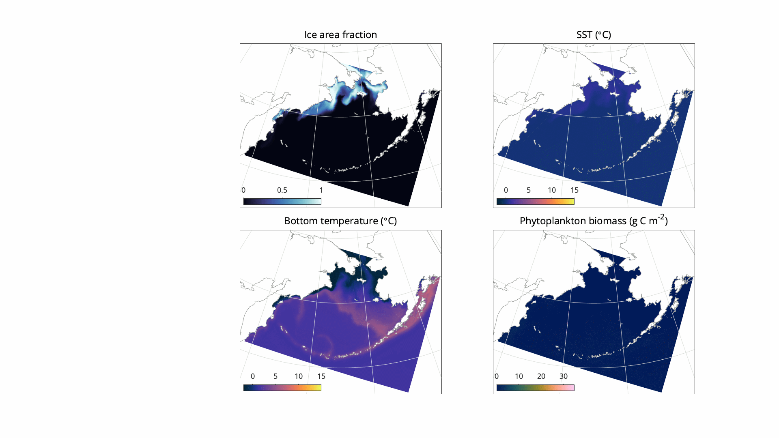
Getting to know the Bering10K dataset

Slide 2
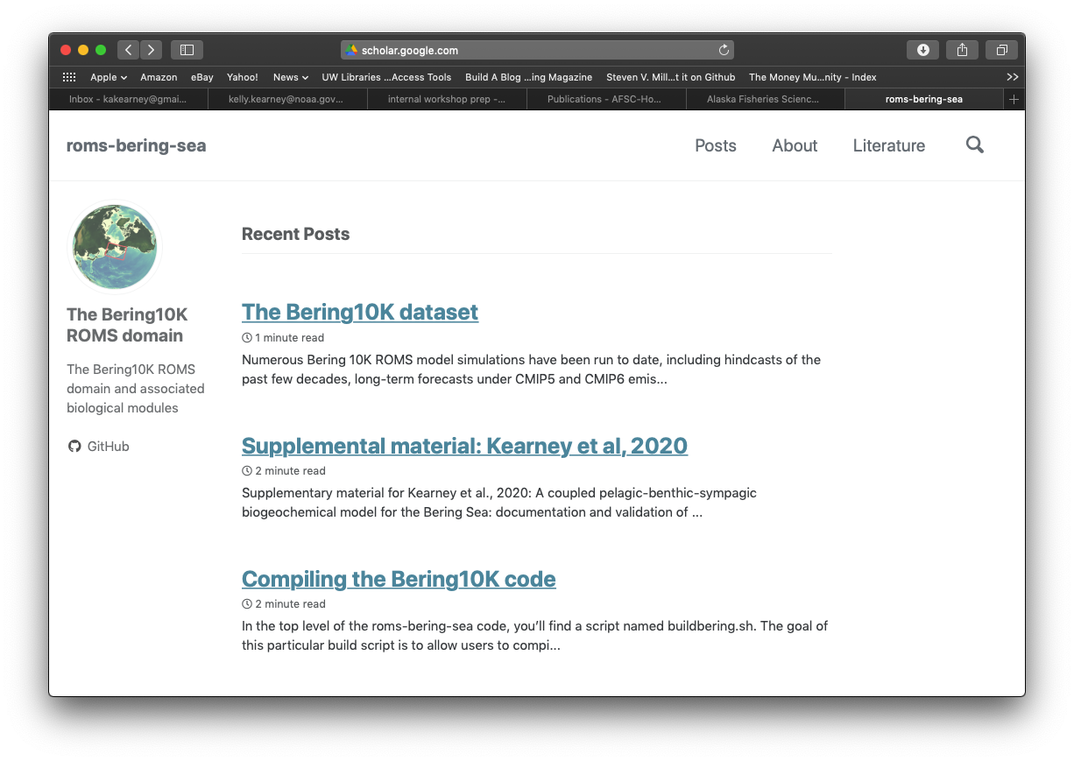
More info
https://beringnpz.github.io/roms-bering-sea/

Slide 3
The “moving parts” of a ROMS model
ROMS kernel
Domain
Simulation details
Physics
(ocean)
Biogeo-chemistry
Horizontal grid
Vertical parameters
External forcing
Archiving options
Sediment
Sea Ice
Compilation options
Input parameters
Time span and time step

Slide 4
The “moving parts” of a ROMS model
ROMS kernel
Domain
Simulation details
1
6 (+3 funded)
1 (+2 funded)
2
27
A few
0
2
A few
A few
A lot
Number of different variants within the Bering10K dataset.
Note: This does not include previous Gulf of Alaska (GOA) or Northeast Pacific (NEP) models!

Slide 5





What simulations are available?
The operational hindcast
ACLIM Phase 1 CMIP5 long-term forecasts
Carbon-enhanced CMIP5 long-term forecasts
ACLIM Phase 2 CMIP6 long-term forecasts
Seasonal forecasts

Slide 6
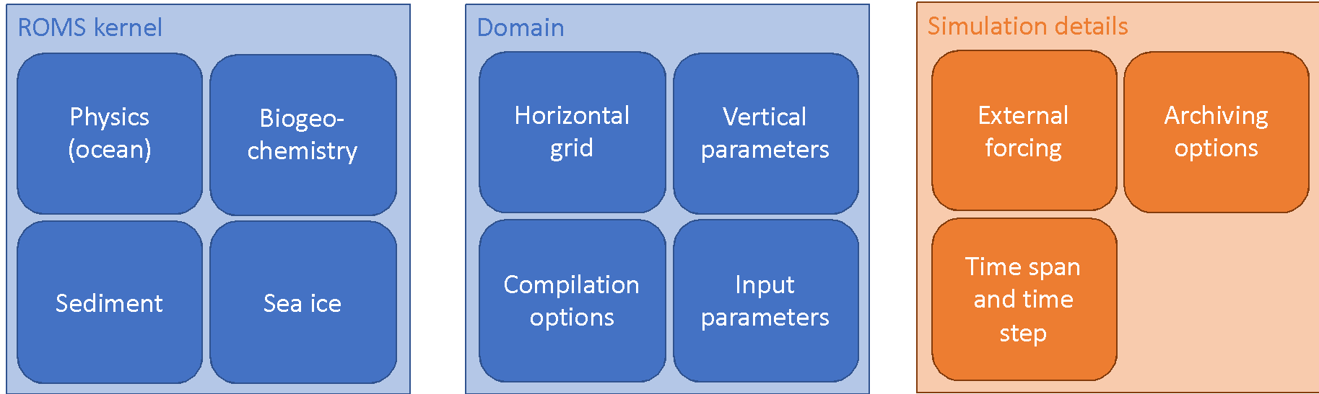
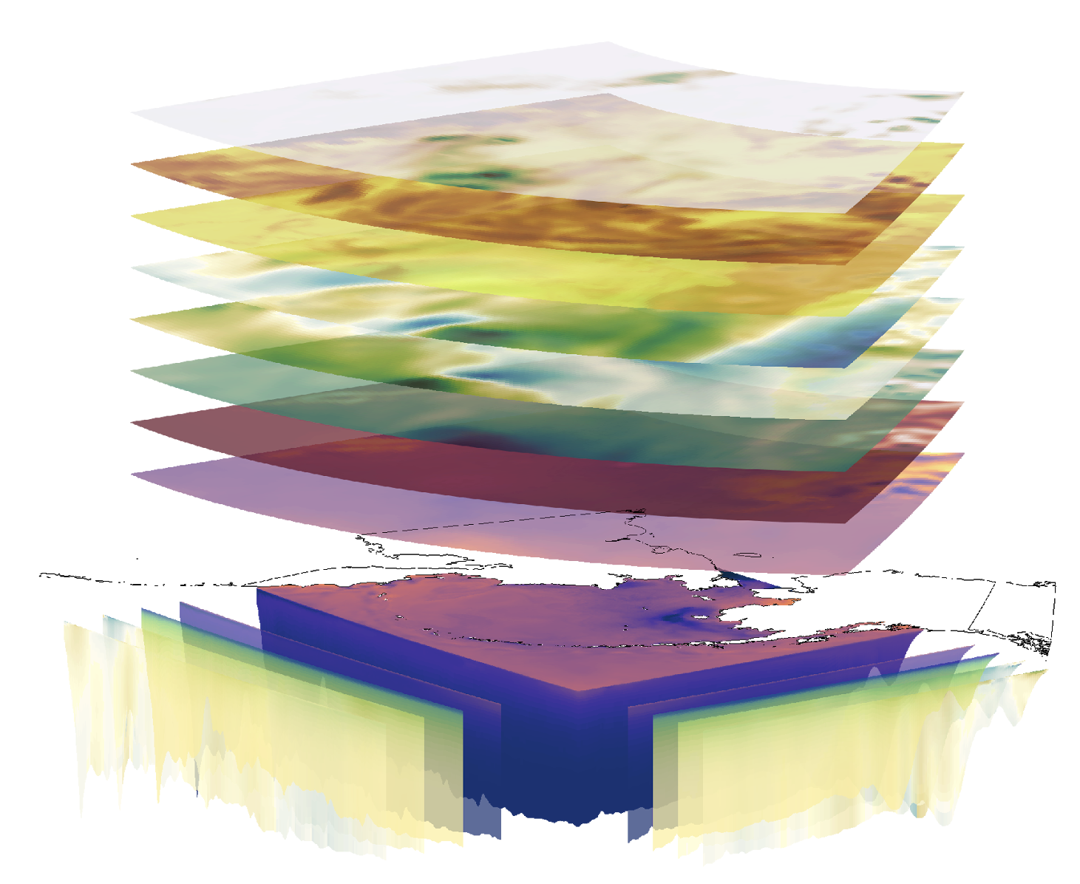
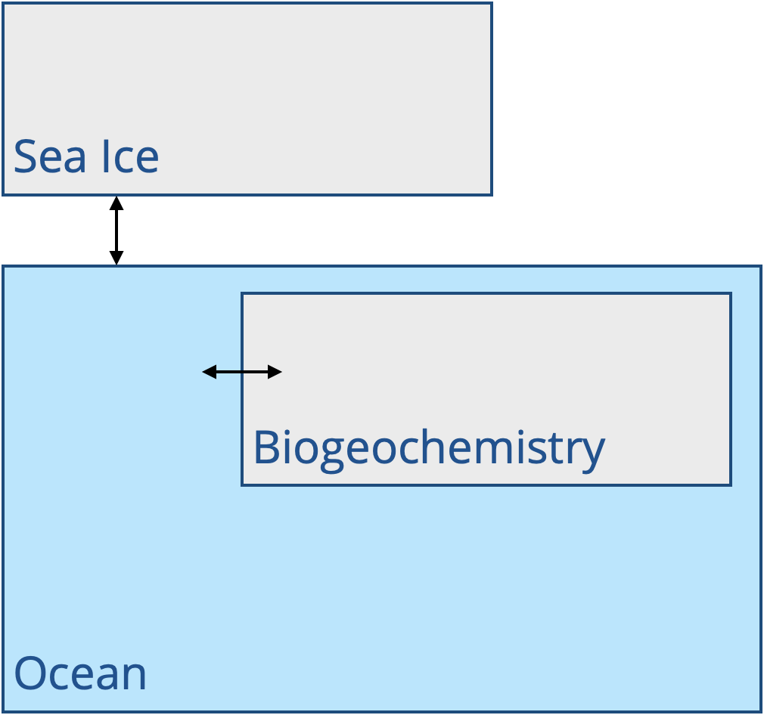
The dataset naming scheme
1) ROMS Kernel and domain
2) Input forcing: atmospheric and lateral boundary conditions
Notes:
The moving parts: boundary forcing, grid-related input (grid, tides, clim. forcing), compiled model version, input parameters

Slide 7
The dataset naming scheme
1) ROMS Kernel and domain
Name | Publication | # layers | Biology (BESTNPZ) version | Carbon system
H13 | Hermann et al., 2013 | 10 | 1st generation | no
H16 | Hermann et al., 2016 | 10 | 1st generation with minor updates | no
P19 | Pilcher et al., 2019 | 10 | Same as H16 | yes
K20 | Kearney et al., 2020 | 30 | 2nd generation | no
K20P19 | Combines features from K20 and P19 | 30 | 2nd generation | yes
Notes:
The moving parts: boundary forcing, grid-related input (grid, tides, clim. forcing), compiled model version, input parameters

Slide 8
The dataset naming scheme
2) Input forcing: atmospheric and lateral boundary conditions
Name | Type of simulation | Forcing source | Timespan
CORECFS | hindcast | Reanalysis data (CORE2, CFSR, and CFS Operational Analysis) | 1970-present
CMIP5 | Long-term forecast | 5th phase Climate Model Intercomparison Project: 3 models, 2 RCPs | 2006-2100
CMIP6 | Long-term forecast | 6th phase Climate Model Intercomparison Project: 3 models, 3 SSPs + historical | 1980-2100
NMME | Seasonal retrospective forecast | North American Multi-model ensemble: CFS and CanCM4 | 1982-2010 (9-12 months each)
Notes:
The moving parts: boundary forcing, grid-related input (grid, tides, clim. forcing), compiled model version, input parameters

Slide 9



Working with simulation data
The native grid
Regional cautions
Variables available
Notes:
Post-processing levels

Slide 10
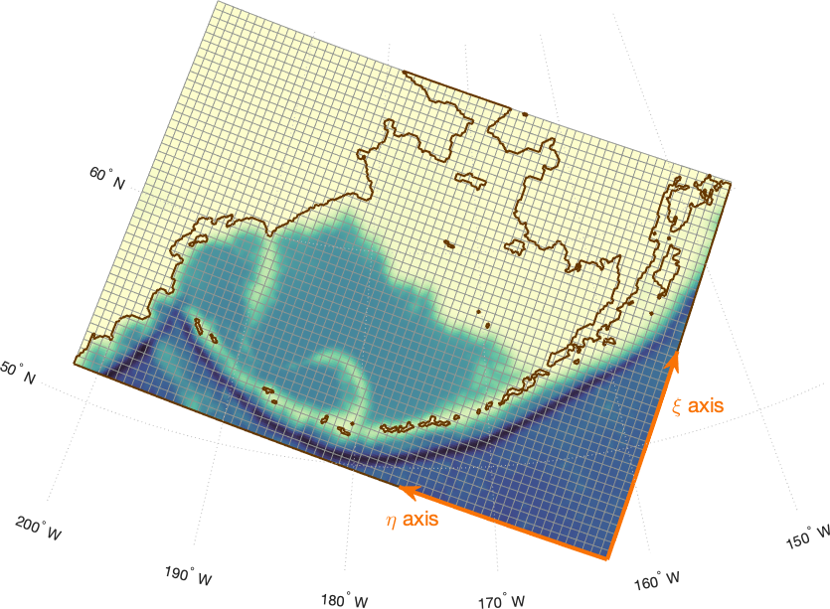
The native grid
Curvilinear horizontal coordinates
Terrain-following vertical coordinates
Staggered grid for different variable types.
Shown at ¼ resolution

Slide 11
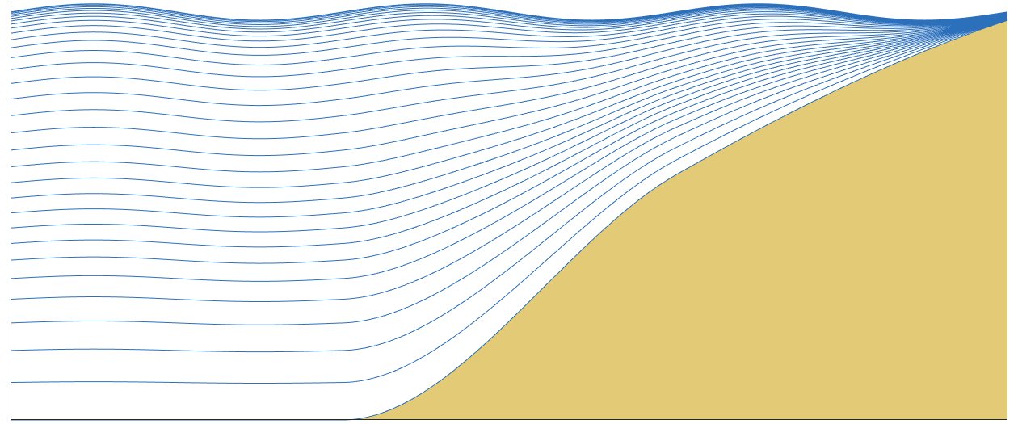
The native grid
Curvilinear horizontal coordinates
Terrain-following vertical coordinates
Staggered grid for different variable types.

Slide 12
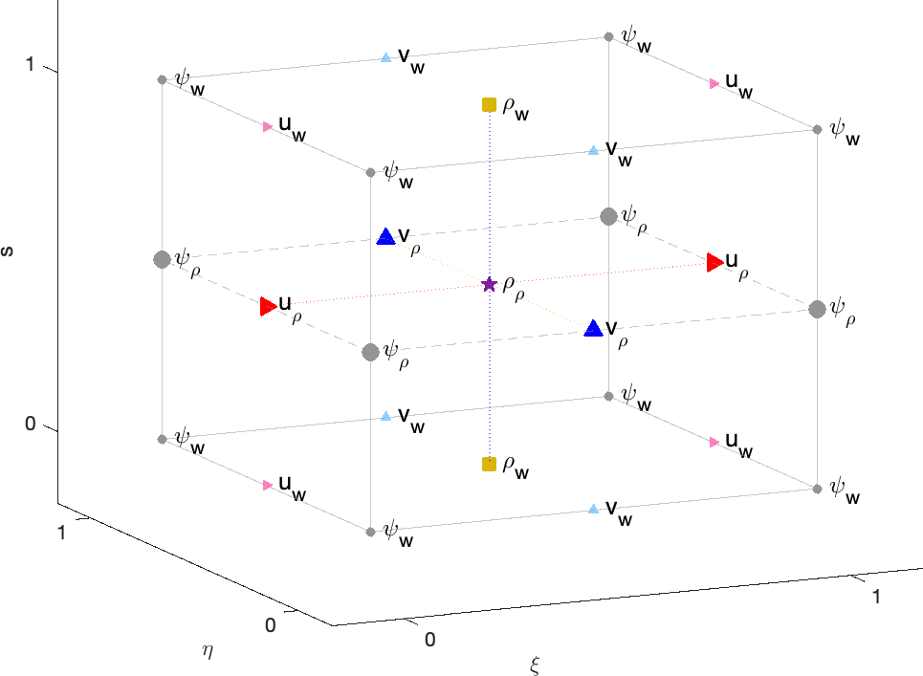
The native grid
Curvilinear horizontal coordinates
Terrain-following vertical coordinates
Staggered grids for different variable types.

Slide 13
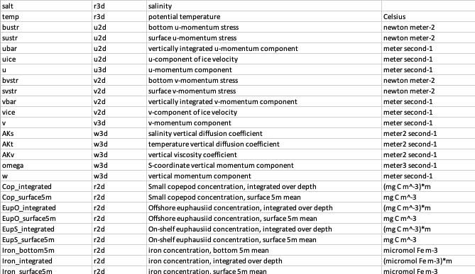
Variables
If a variable is available, that does not mean it has skill.
If a variable has not been validated, that does not mean it is lacking skill.
Notes:
148 Level 1 variables
“internal ice stress 11 component” (i.e. major axis)

Slide 14
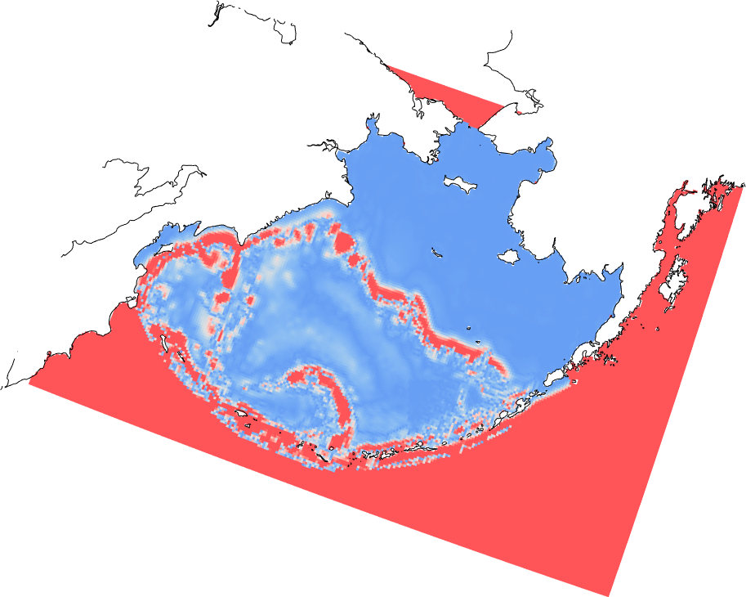



Regional cautions
The model was designed primarily for the eastern Bering Sea shelf. The model may not perform as skillfully away from this region.
Steep topography is a modeling challenge!
Boundary condition artifacts are present near the edges of the domain.
Safe territory
Beware!
Here be dragons…
Notes:
Some things to know: where to be wary (outside Bering Sea, along steep topography)

Slide 15




Where is the data?
THREDDS Server
Live Access Server
ERDDAP Server
UW Hyak-mox computer

Slide 16
Output variable organization
Level 0: raw output
averages: full grid, time-binned averages (typically weekly)
history: full grid, instantaneous snapshots (typically weekly)
station: select locations, time-vs-depth snapshots (1-4 times daily)
Level 1: same data as Level 0 but in a more user-friendly format, native grid
Level 2: additional variables added in post-processing, native grid
3D to 2D transforms (Surface/bottom/integrated)
Pre-calculated depths
Geographically-rotated u/v components
Level 3: more highly processed indices
Cold pool index
ACLIM regional indices
ACLIM survey-replicated indices
Regridded data

